Slide 1
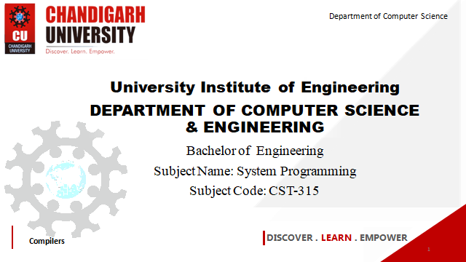


Department of Computer Science
University Institute of Engineering
DEPARTMENT OF COMPUTER SCIENCE & ENGINEERING
Bachelor of Engineering
Subject Name: System Programming
Subject Code: CST-281
Compilers
DISCOVER . LEARN . EMPOWER

Slide 2
Chapter-1.3 Macro
Department of computer Science
Design of a Macro Assembler,
Features of Macro Processors
Functions of a Macro Processor
Basic Tasks of a Macro Processor
Design Issues of macro processors

Slide 3
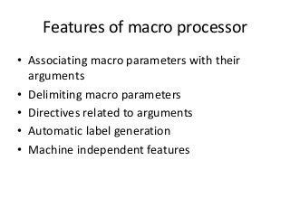

Slide 4
Macro Assembler
An assembler that brings high-level language features to assembly language programming. It translates a single multi-argument source line o code into a sequence of machine instructions.
A macro assembler is able to generate a program segment, which is defined by a macro, when the name of the macro appears as an opcode in a program. The macro assembler is still capable of regular assembler functioning, generating a machine instruction for each line of assembly language code; but like a compiler, it can generate many machine instructions from one line of source code. Its instruction set can be expanded to include new mnemonics, which generate these program segments of machine code.

Slide 5
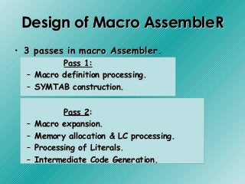

Slide 6
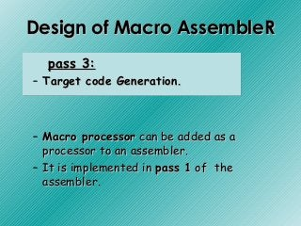
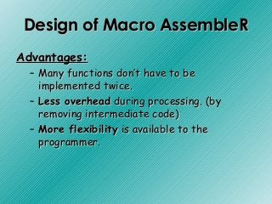

Slide 7
Pass 1
READ
Search
(Pseudo-Op Table)
Pass 2
R
Type?
Search NAMTAB
(Macro Name Table)
MACRO
Define
Process
pseudo-ops
Search
(Machine Op Table)
R
R
MACRO
Expand
Process machine instruction
R
Macro Assembler Flow Chart
R

Slide 8
Disadvantages(Macro assembler):
• Combined pass 1 of the assembler & macro processor may be too large for the program to fit into core of some machine.
Complexity of such program may be overwhelming.

Slide 9
Functions of a Macro Processor
Source Code
(with macro)
Macro Processor
Expanded Code
Compiler or Assembler
obj

Slide 10
Functions of a Macro Processor
Recognize macro definitions
Save the macro definition
Recognize macro calls
Expand macro calls
Source Code
(with macro)
Macro Processor
Expanded Code
Compiler or Assembler
obj

Slide 11
BASIC Tasks of MACRO PROCESSOR
The fundamental functions common to all macro processors are:
Macro Definition
Macro Invocation
Macro Expansion
(Already covered in PPT 1.3.1)

Slide 12
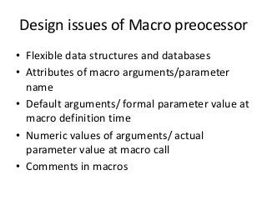

Slide 13
References
John J Donovan Systems Programming Ebook Wordpress (pdflife.one)
[PDF] Systems Programming and Operating Systems by Dhamdhere - Free Download PDF (dlscrib.com)

Slide 14

THANK YOU

